Slide 1
Preliminary Design
Friday, December 7th 2012

Slide 2
Agenda
Requirements Inventory
Testing Plan
Development and Production Environments
Prototype Screens
Project Timeline
Data Dictionary
Activity Diagram
Data Flow Diagrams
Introduction
Website Map
Deployment Diagram
Use Case Diagram
User Case Narratives
Project Progression
Restatement of Problem

Slide 3
Welcome
Our Client:
Dr. Darren Lim
Professor of Computer Science
Siena College

Slide 4
Introduction
Christopher Small
Team Leader
Alyssa Nghiem
Web Master
Eduardo Pinto Barbosa
Document Analyst
Tyler Vorpahl
Lead Graphic Designer
& Co-Web Master
Ryan Kennedy
Lead Developer

Slide 5
Agenda
Requirements Inventory
Testing Plan
Development and Production Environments
Prototype Screens
Project Timeline
Data Dictionary
Activity Diagram
Data Flow Diagrams
Introduction
Website Map
Deployment Diagram
Use Case Diagram
User Case Narratives
Project Progression
Restatement of Problem

Slide 6
Problem
Consortium for Computing Sciences in Colleges North East (CCSCNE) Conference
The CCSCNE conference is complex and difficult to manage

Slide 7
WORMS
Web Organization Registration Management System
Integrated System that handles…
Attendee Registration
Scholarly Works Submission
Scholarly Works Review
Information Access

Slide 8
Agenda
Requirements Inventory
Testing Plan
Development and Production Environments
Prototype Screens
Project Timeline
Data Dictionary
Activity Diagram
Data Flow Diagrams
Introduction
Website Map
Deployment Diagram
Use Case Diagram
User Case Narratives
Restatement of Problem
Project Progression

Slide 9
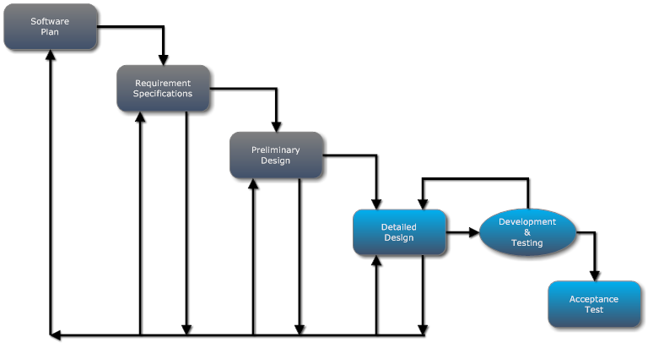
Project Progression

Slide 10
Agenda
Requirements Inventory
Testing Plan
Development and Production Environments
Prototype Screens
Project Timeline
Data Dictionary
Activity Diagram
Data Flow Diagrams
Introduction
Website Map
Deployment Diagram
Use Case Diagram
Restatement of Problem
Project Progression
User Case Narratives

Slide 11
User Case Narratives
Describes the capabilities of each user in detail
We will only show outlines here

Slide 12
Use Case Narrative: Reviewer
Submits credentials for approval
Views a list of works assigned for review
Submits a review for each assigned work

Slide 13
Use Case Narrative: Submitter
Uploads a scholarly work
Selects a topic for the work
Able to check whether the submission has been reviewed
Receives a notification via email of acceptance or rejection

Slide 14
Agenda
Requirements Inventory
Testing Plan
Development and Production Environments
Prototype Screens
Project Timeline
Data Dictionary
Activity Diagram
Data Flow Diagrams
Introduction
Website Map
Deployment Diagram
Restatement of Problem
Project Progression
User Case Narratives
Use Case Diagram

Slide 15
Use Case Diagram
Shows actors that interact with the system
Shows which system features each actor interacts with

Slide 16
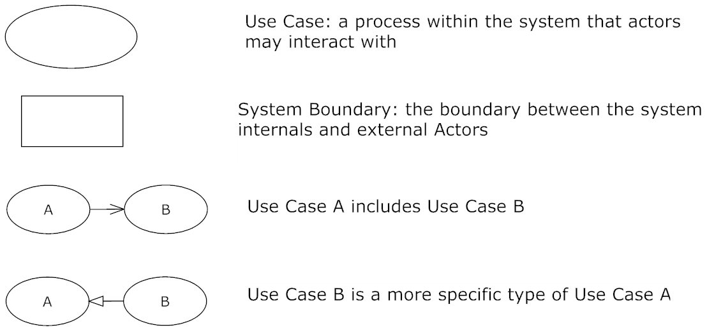
Use Case Diagram Legend

Slide 17
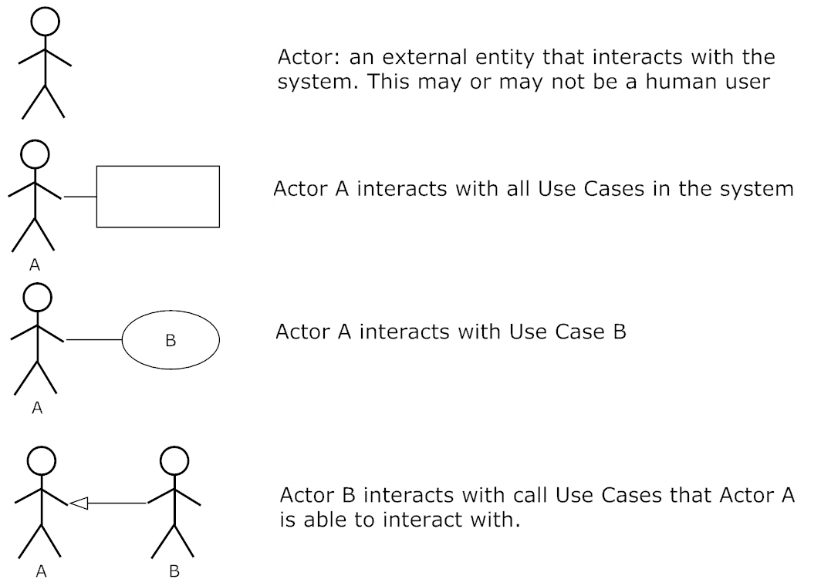
Use Case Diagram Legend

Slide 18
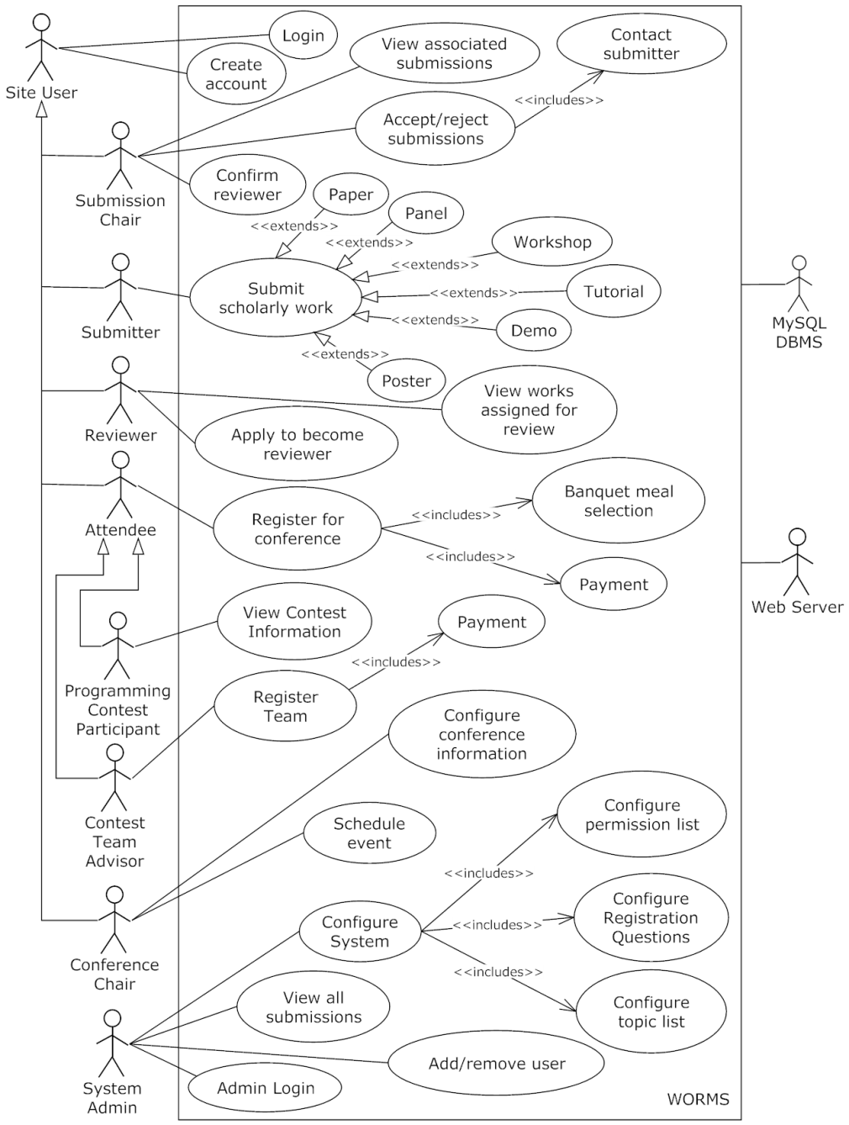
Use Case Diagram

Slide 19
Agenda
Requirements Inventory
Testing Plan
Development and Production Environments
Prototype Screens
Project Timeline
Data Dictionary
Activity Diagram
Data Flow Diagrams
Introduction
Website Map
Restatement of Problem
Project Progression
User Case Narratives
Use Case Diagram
Deployment Diagram

Slide 20
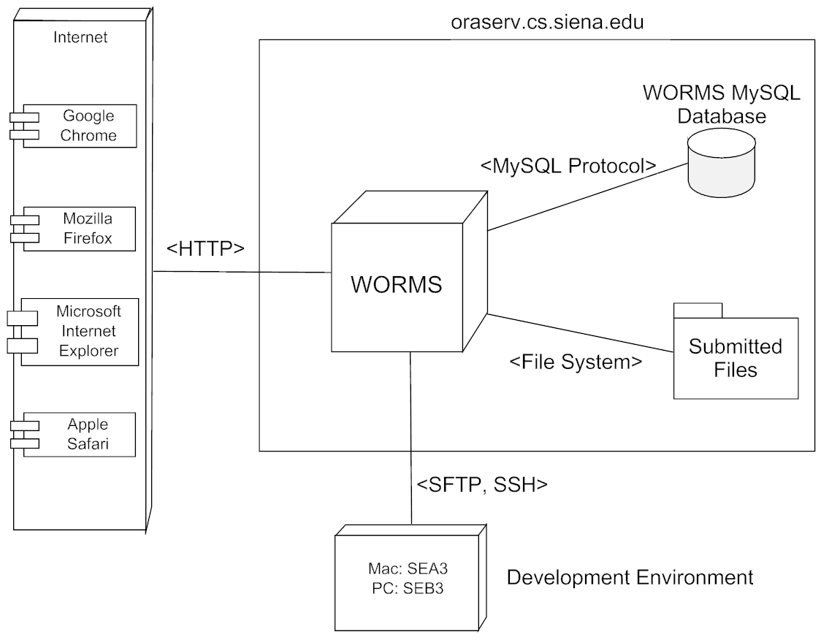
Deployment Diagram

Slide 21
Agenda
Requirements Inventory
Testing Plan
Development and Production Environments
Prototype Screens
Project Timeline
Data Dictionary
Activity Diagram
Data Flow Diagrams
Introduction
Deployment Diagram
Restatement of Problem
Project Progression
User Case Narratives
Use Case Diagram
Website Map

Slide 22
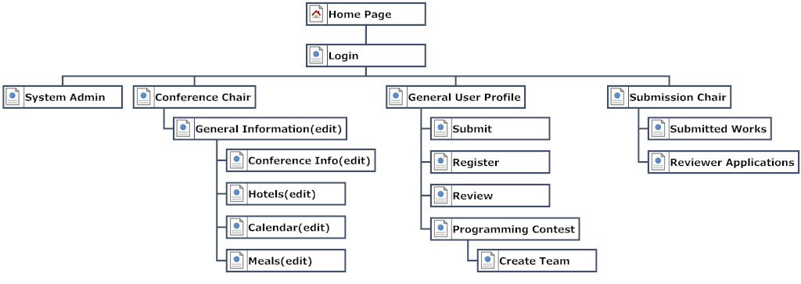
Website Map

Slide 23
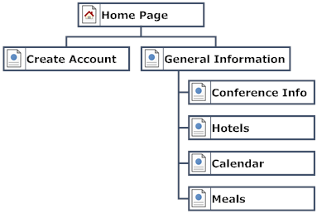
Website Map

Slide 24
Agenda
Requirements Inventory
Testing Plan
Development and Production Environments
Prototype Screens
Project Timeline
Data Dictionary
Website Map
Data Flow Diagrams
Introduction
Deployment Diagram
Restatement of Problem
Project Progression
User Case Narratives
Use Case Diagram
Activity Diagram

Slide 25
Activity Diagram
Graphical representation of a process
Shows a series activities and decisions

Slide 26
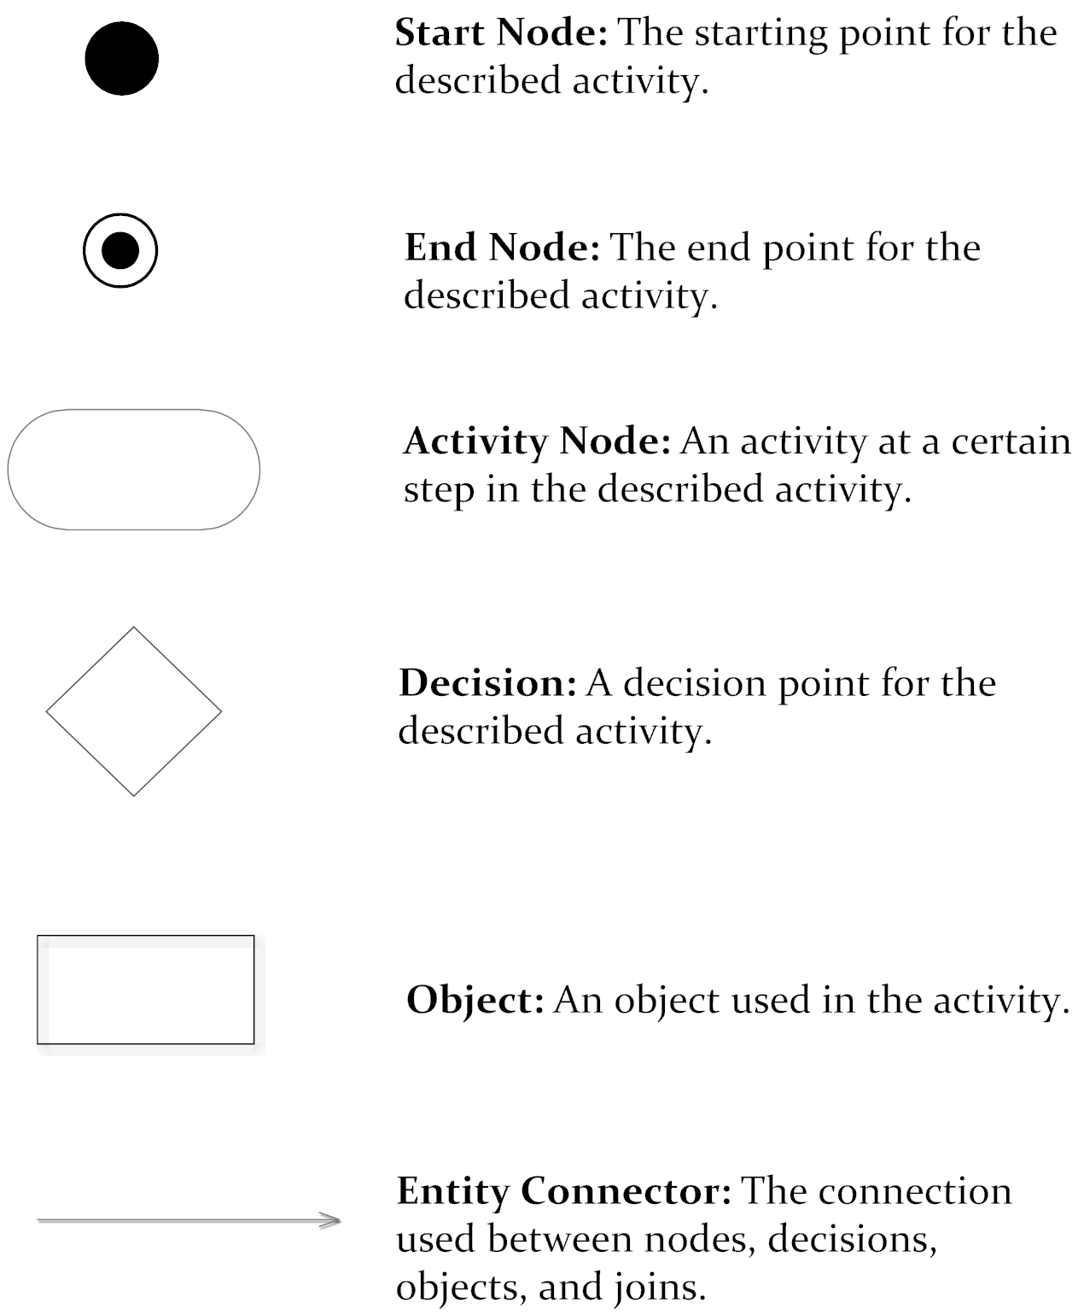
Activity Diagram

Slide 27
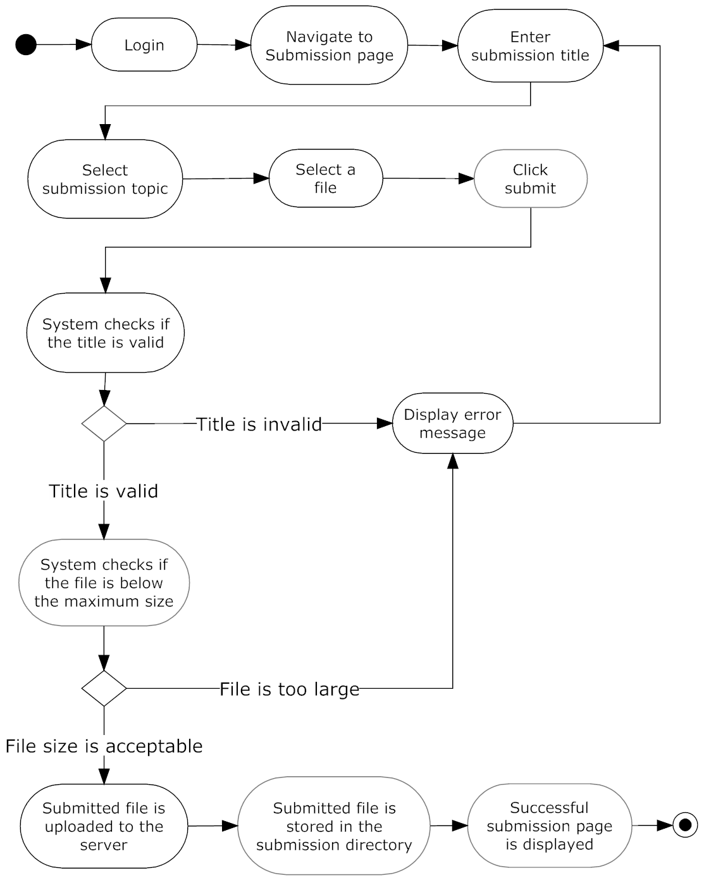
Activity Diagram - Submission

Slide 28
Agenda
Requirements Inventory
Testing Plan
Development and Production Environments
Prototype Screens
Project Timeline
Data Dictionary
Website Map
Activity Diagram
Introduction
Deployment Diagram
Restatement of Problem
Project Progression
User Case Narratives
Use Case Diagram
Data Flow Diagrams

Slide 29
Data Flow Diagram
Explains the movement of data between processes in the system and entities outside the system

Slide 30
Data Flow Diagram Legend

Slide 31
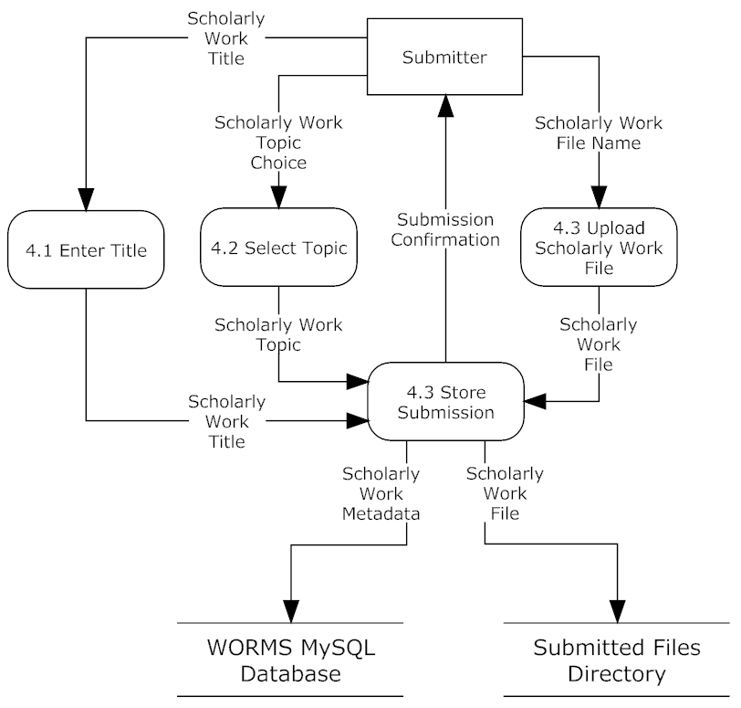
Process 4 - Submission

Slide 32
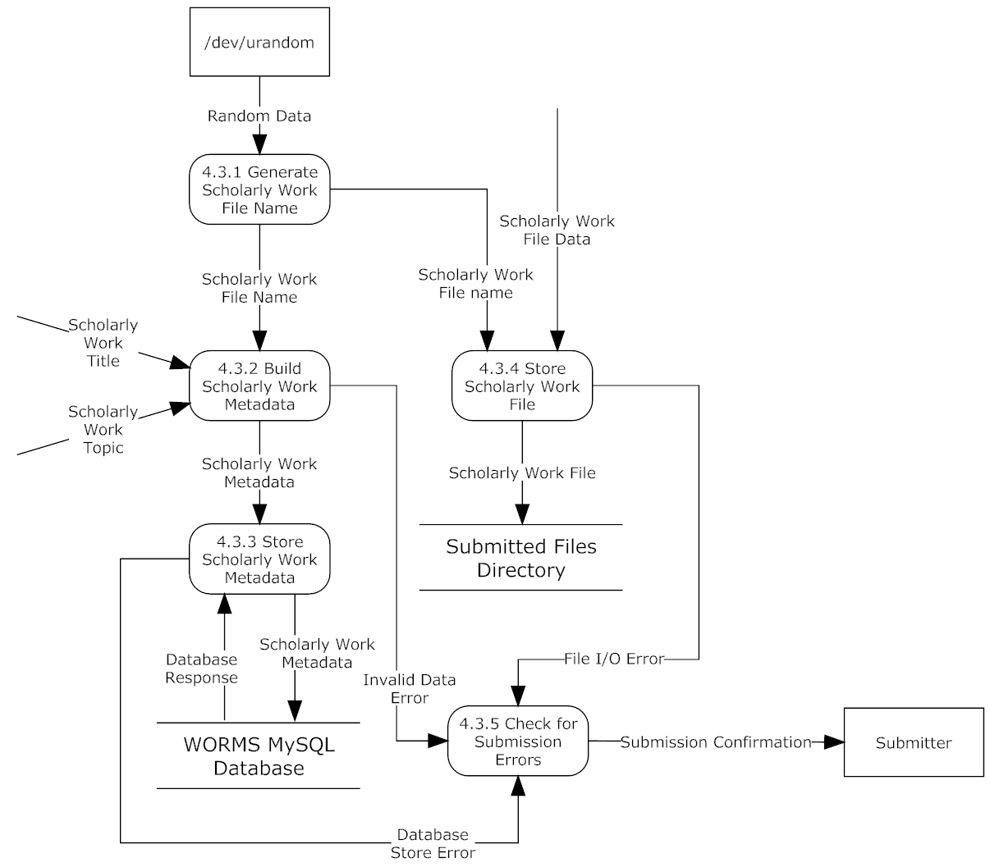
Process 4.3 Store Submission

Slide 33
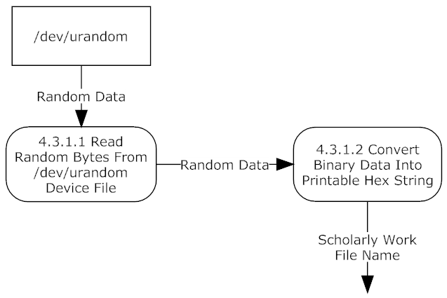
Process 4.3.1 – Generate Scholarly Work File Name

Slide 34
Agenda
Data Flow Diagrams
Testing Plan
Development and Production Environments
Prototype Screens
Project Timeline
Data Dictionary
Website Map
Activity Diagram
Introduction
Deployment Diagram
Restatement of Problem
Project Progression
User Case Narratives
Use Case Diagram
Requirements Inventory

Slide 35
Non-Functional Requirements
Easy to use
Easy to maintain

Slide 36
Functional Requirements Inventory
Submitter
Uploads scholarly work as PDF
Selects a topic for the scholarly work
Receives an email notification of acceptance or rejection

Slide 37
Functional Requirements Inventory
Reviewer
Submits credentials for approval
Views assigned works
Submit a review for each assigned work

Slide 38
Agenda
Data Flow Diagrams
Testing Plan
Development and Production Environments
Prototype Screens
Project Timeline
Requirements Inventory
Website Map
Activity Diagram
Introduction
Deployment Diagram
Restatement of Problem
Project Progression
User Case Narratives
Use Case Diagram
Data Dictionary

Slide 39
Data Dictionary
List of key data entities
Data Types
Same as DBMS if applicable
VARCHAR, INT, BOOL, and others
Data size
Short data description
Examples of acceptable and invalid data

Slide 40
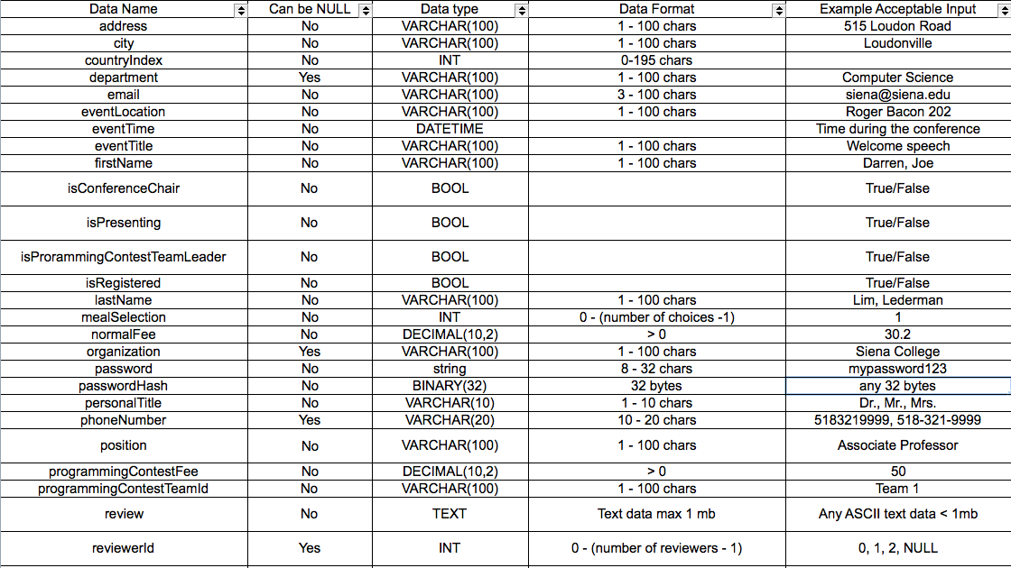
Data Dictionary

Slide 41
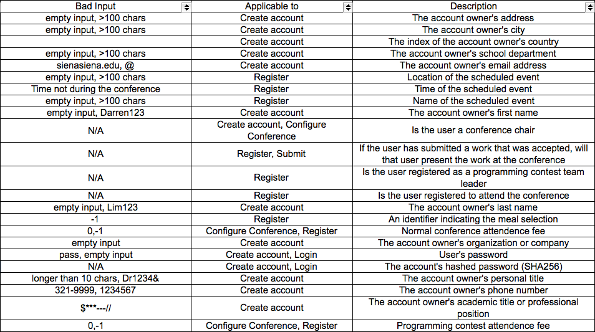
Data Dictionary

Slide 42
Agenda
Data Flow Diagrams
Development and Production Environments
Prototype Screens
Project Timeline
Data Dictionary
Website Map
Activity Diagram
Introduction
Deployment Diagram
Restatement of Problem
Project Progression
User Case Narratives
Use Case Diagram
Requirements Inventory
Testing Plan

Slide 43
Testing
Unit Tests
Ensure that each major process of the software functions properly
Made up of Test Cases
Test Case – an individual test within a component of the software
Acceptance Test – does the software provide the functionality the client needs?

Slide 44
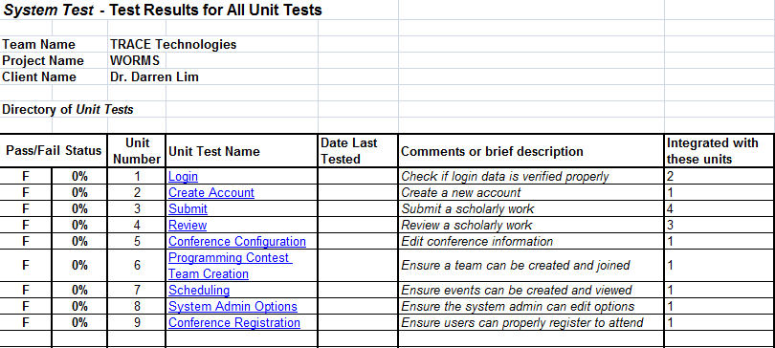
Unit Test Directory

Slide 45
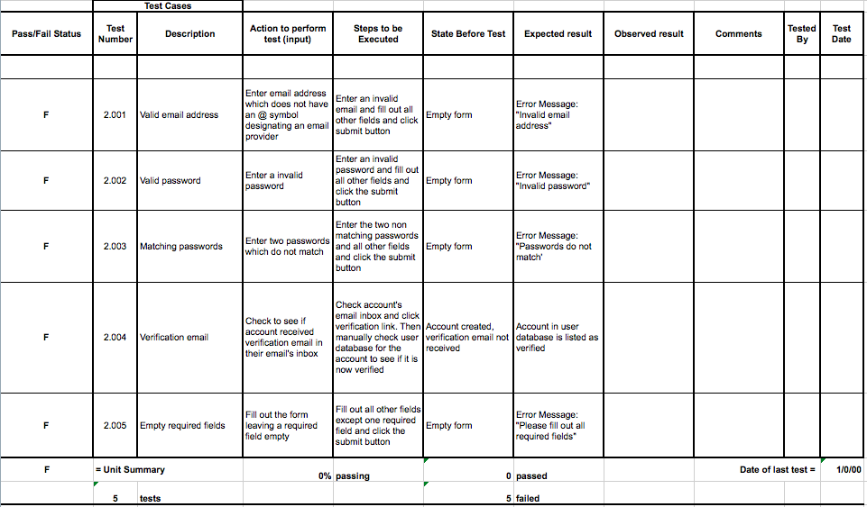
Unit Tests – Create Account

Slide 46
Agenda
Data Flow Diagrams
Testing Plan
Prototype Screens
Project Timeline
Data Dictionary
Website Map
Activity Diagram
Introduction
Deployment Diagram
Restatement of Problem
Project Progression
User Case Narratives
Use Case Diagram
Requirements Inventory
Development and Production Environments

Slide 47
Development Environment
Go compiler version 1.0.3
Dell PC running Windows Vista
iMac running OS X 10.7.4
Notepad++, TextWrangler, vim for text editing
oraserv Linux server
CentOS 5.2 Linux distribution
MySQL DBMS v5.0.45

Slide 48
Production Environment
oraserv will also provide the WORMS production environment

Slide 49
Agenda
Data Flow Diagrams
Testing Plan
Development and Production Environments
Project Timeline
Data Dictionary
Website Map
Activity Diagram
Introduction
Deployment Diagram
Restatement of Problem
Project Progression
User Case Narratives
Use Case Diagram
Requirements Inventory
Prototype Screens

Slide 50
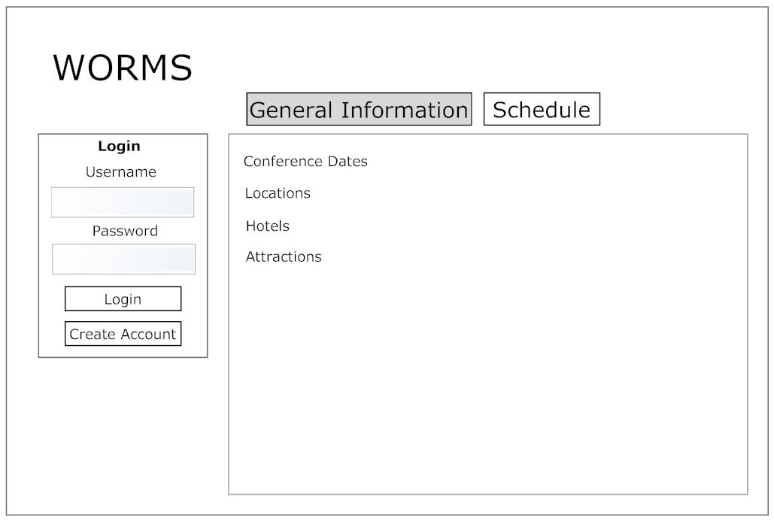
Prototype Screens Main Page

Slide 51
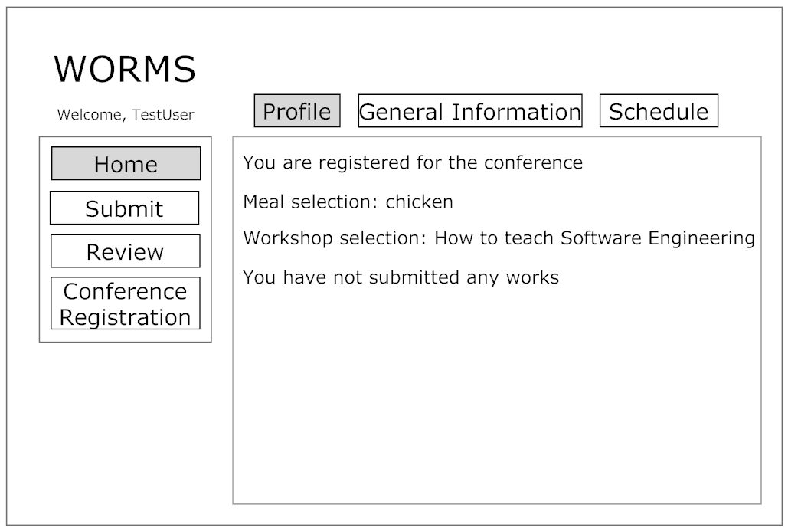
Prototype Screens User Profile

Slide 52
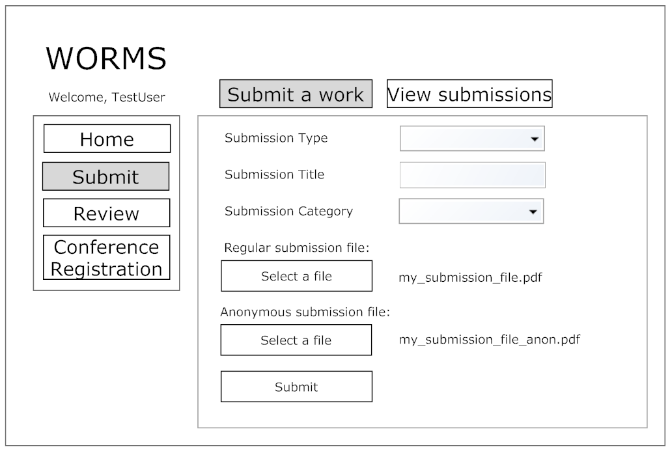
Prototype Screens Submit

Slide 53
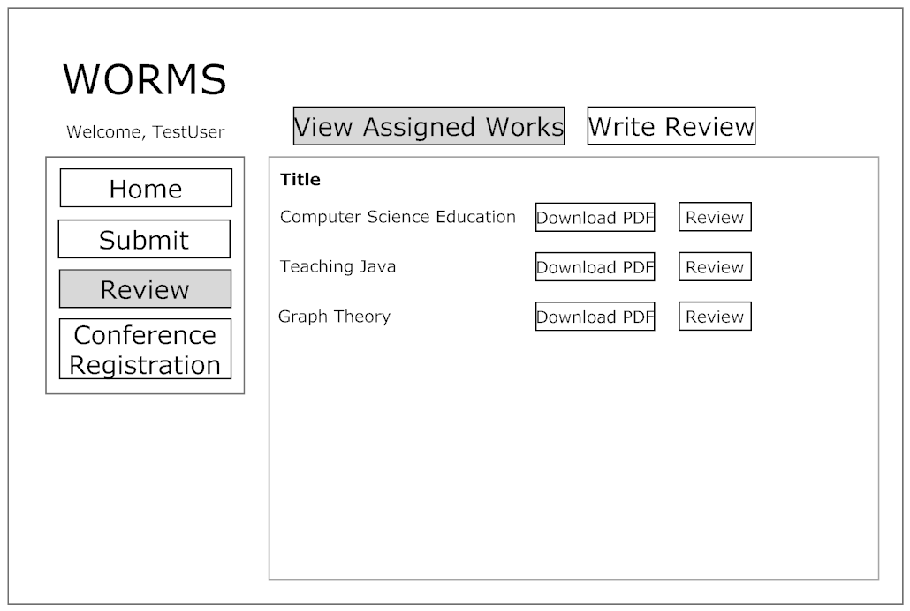
Prototype Screens Review

Slide 54
Agenda
Data Flow Diagrams
Testing Plan
Development and Production Environments
Prototype Screens
Data Dictionary
Website Map
Activity Diagram
Introduction
Deployment Diagram
Restatement of Problem
Project Progression
User Case Narratives
Use Case Diagram
Requirements Inventory
Project Timeline

Slide 55
Project Timeline

Slide 56
The End

